Slide 1

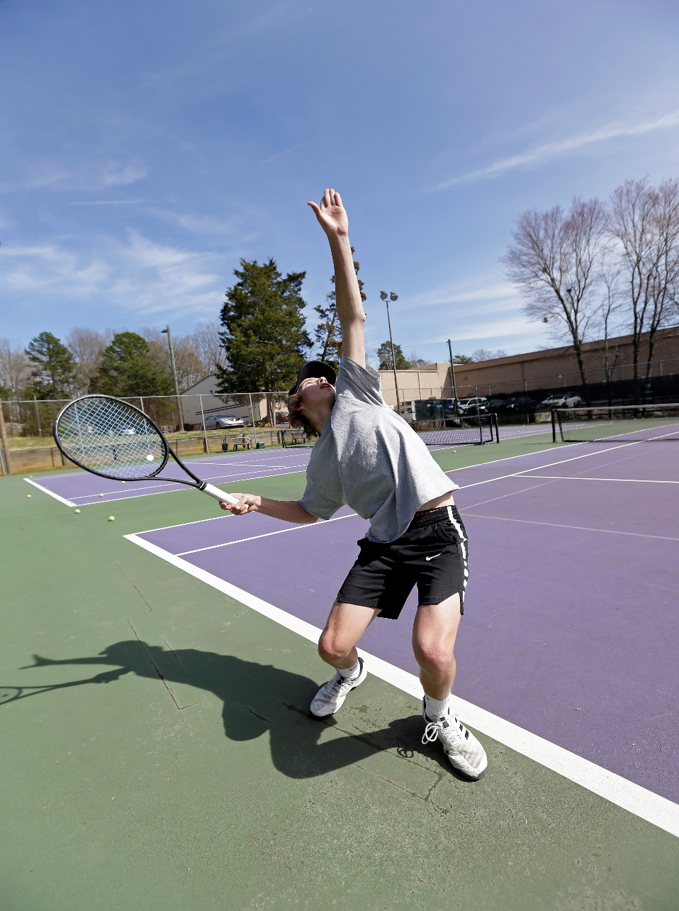
Summer Tennis Camps 2024
At the Sportscenter Tennis Club
Session Dates
6/10 -- 6/13 (Week 1) 6/17 -- 6/20 (Week 2) 6/24 -- 6/27 (Week 3)
6/30 – 7/6 (No Camp)
7/8 -- 7/11 (Week 4)
7/15 – 7-18 (Week 5)
7/22 – 7/25 (Week 6)
Weeks 5 & 6 will also include Girls Middle & High School Pre -Season Camps
11 am to 1:00 pm
Days / Times
Monday – Thursday
9:00 pm to 11:00 pm
For Kids 6-11 yrs. old
Limited to 1st 16 Kids
11:00 am to 1:00 pm
For Kids 12-18 yrs. old
Limited to 1st 16 Kids
*Ages 6 – 18*
Fridays are used as rain make up days for camps!
Cost SC Members Non -SC Members
Daily Rate
Weekly Rate
Two Week Rate $ 35
$ 110
$ 190 $ 45
$ 150
$ 230

Slide 2
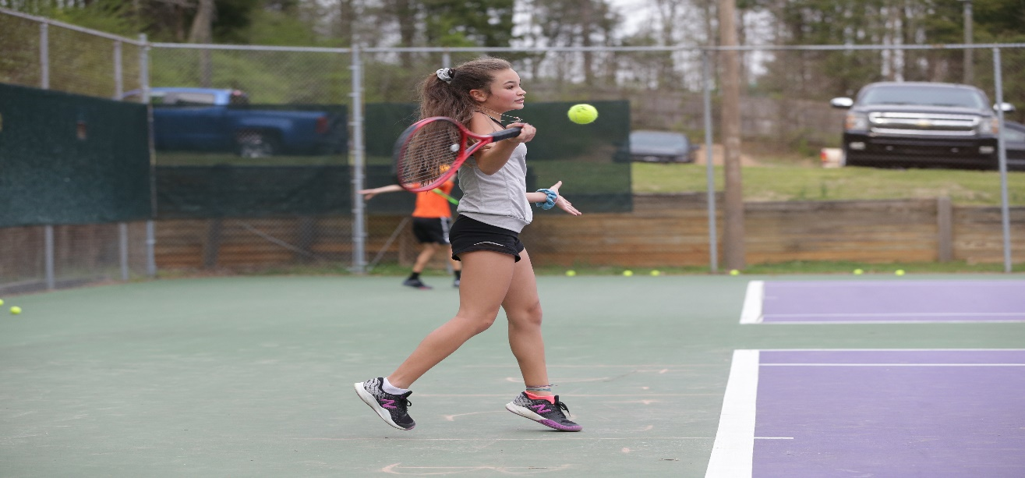
Player Name: ________________________________________
Player Age: _____ School: _____________________________
Player Cell: ________________ Parent Cell: ________________
Player Email: _________________________________________
Parent Email: ________________________________________
Parent Name: ________________________________________
Weeks Attending (circle): 1 2 3 4 5 6
To Register Contact: Mark Allen
704-906-3123
mark.allen@sportscenternc.com

