Slide 1
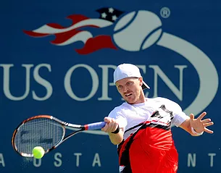
Alex Bogomolov Summer Performance Academy
At the Sportscenter Club
Dates
ANNOUNCG!!
6/11 – 6/28 (Session 1)
6/29 – 7/8 (OFF)
7/9 -- 8/2 (Session 2)
Days /Times
Monday –Thursday
1:00 pm to 5:30 pm
Come train with former ATP Tour Professional Alex Bogomolov and former Division 1 Player Mark Allen at the Sportscenter in Concord this summer.
Sample Schedule
1:00 – 1:15 Dynamic Warm Up
1:15 – 2:30 Shot Pattern Rotations
2:30 – 3:30 Strength & Conditioning *Ages 12 – 20*
3:30 – 4:00 Match Strategies & Tactics
4:00 – 5:30 Supervised Match & Point Playing
Cost SC Members Non SC Members
Daily Rate $ 120 $ 150
Weekly Rate $ 320 $ 400
Session 1 Rate $ 768 $ 960
Session 2 Rate $ 1,024 $ 1,280
*Limited to the first 18 kids to sign up so do it now!

